Slide 1
Tree Traversal

Slide 2
Content
Universal address systems
Traversal algorithms
  Depth-first traversal:
    Preorder traversal
    Inorder traversal
    Postorder traversal
  Breadth-first traversal
Infix/prefix/postfix notation
School of Computer Science, BUPT

Slide 3
Universal address systems
Label all the vertices
  Label the root with the integer 0. Then label its k children from left to right with 1,2,…k.
  For each vertex v at level n with label A, label its k_{v} children, as they are drawn from left to right, with A.1,A.2,…A. k_{v}.
School of Computer Science, BUPT

Slide 4
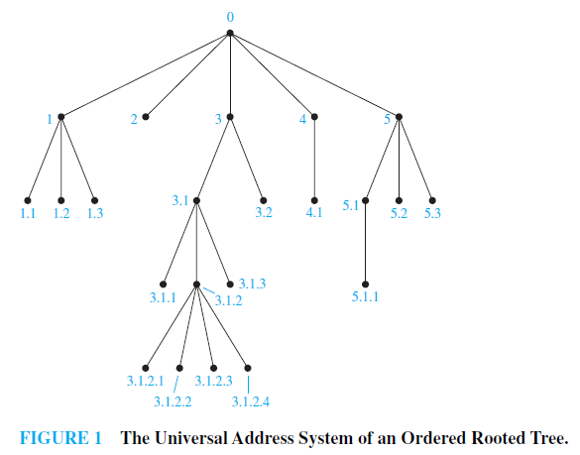
Example 1
School of Computer Science, BUPT

Slide 5
Traversal algorithms
Procedures for systematically visiting every vertex of an ordered rooted tree are called traversal algorithms.
  Preorder traversal
  Inorder traversal
  Postorder traversal
School of Computer Science, BUPT

Slide 6
Preorder traversal
Definition 1
  Let T be an ordered rooted tree with root r.
    If T consists only of r, then r is the preorder traversal of T .
    Otherwise, suppose that T₁, T₂, . . . , T_{n} are the subtrees at r from left to right in T .
      The preorder traversal begins by visiting r.
      It continues by traversing T₁ in preorder, then T₂ in preorder, and so on, until T_{n} is traversed in preorder.
School of Computer Science, BUPT

Slide 7
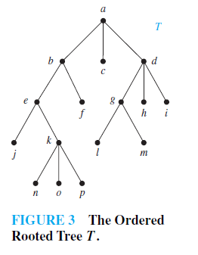
Preorder traversal
Example 2
School of Computer Science, BUPT

Slide 8
Preorder traversal
Algorithm1 Preorder traversal
  Procedure preorder (T: ordered rooted tree)
  r:=root of T
  list r
  For each child c of r from left to right
  begin
  T(c):=subtree with c as its root
  Preorder (T(c))
  end
School of Computer Science, BUPT

Slide 9
Inorder traversal
Definition 2
Let T be an ordered rooted tree with root r.
  If T consists only of r, then r is the inorder traversal of T .
  Otherwise, suppose that T₁, T₂, . . . , T_{n} are the subtrees at r from left to right.
    The inorder traversal begins by traversing T₁ in inorder,
    then visiting r.
    It continues by traversing T₂ in inorder, then T₃ in inorder, . . . , and finally T_{n} in inorder.
School of Computer Science, BUPT

Slide 10
Inorder traversal
Example 3
School of Computer Science, BUPT

Slide 11
Inorder traversal
Algorithm2 Inorder traversal
  Procedure inorder (T: ordered rooted tree)
  r:=root of T
  if r is a leaf then list r
  else
  begin
  l:=first child of r from left to right
  T(l):=subtree with l as its root
  inorder (T(l))
  list r
  For each child c of r except for l from left to right
  T(c):=subtree with c as its root
  inorder (T(c))
  end
School of Computer Science, BUPT

Slide 12
Postorder traversal
Definition 3
Let T be an ordered rooted tree with root r.
  If T consists only of r, then r is the postorder traversal of T .
  Otherwise, suppose that T₁, T₂, . . . , T_{n} are the subtrees at r from left to right.
    The postorder traversal begins by traversing T₁ in postorder,
    then T₂ in postorder, . . . ,then T_{n} in postorder, and
    ends by visiting r.
School of Computer Science, BUPT

Slide 13
Postorder traversal
Example 4
School of Computer Science, BUPT

Slide 14
Postorder traversal
Algorithm3 Postorder traversal
  Procedure postorder (T: ordered rooted tree)
  r:=root of T
  For each child c of r from left to right
  begin
  T(c):=subtree with c as its root
  Postorder (T(c))
  end
  list r
School of Computer Science, BUPT

Slide 15
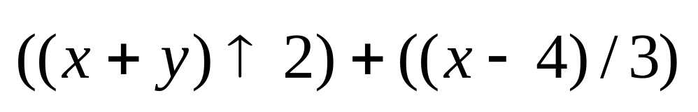
Example 5
School of Computer Science, BUPT

Slide 16
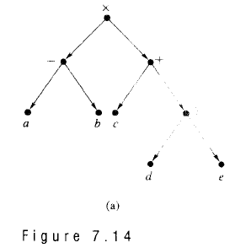
Infix notation（中缀表示法）
ambiguous
School of Computer Science, BUPT

Slide 17
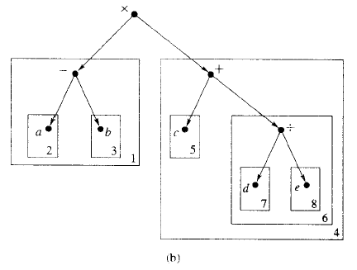
Prefix（前缀）
School of Computer Science, BUPT

Slide 18
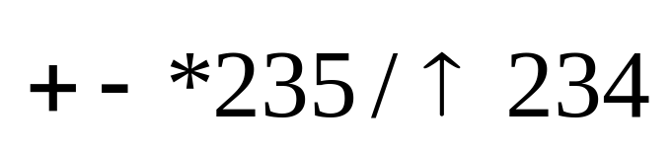
Prefix(Polish Form) （前缀表达式（波兰式））
Unambiguously without parentheses
from right to left Fxy
operation symbol precedes the argument
Example 7
School of Computer Science, BUPT

Slide 19
Postfix（后缀表达式）
ab-cde+
a=2,b=1,c=3
d=4,e=2
School of Computer Science, BUPT

Slide 20
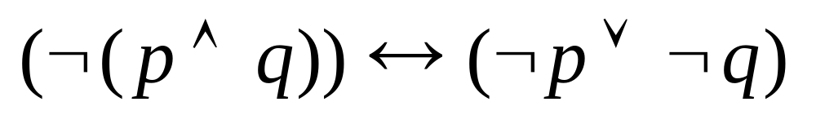
Example 10
School of Computer Science, BUPT

Slide 21
Homework
§11.3
  6, 22
School of Computer Science, BUPT

Slide 22
Spanning Trees

Slide 23
Introduction
School of Computer Science, BUPT

Slide 24
Definition 1
Let G be a simple graph. A spanning tree of G is a subgraph of G that is a tree containing every vertex of G.
School of Computer Science, BUPT

Slide 25
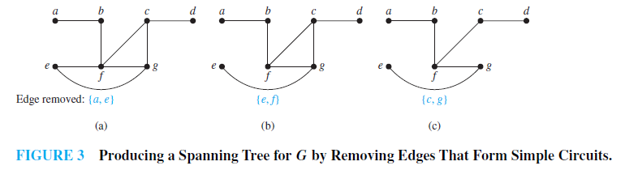
Example 1
School of Computer Science, BUPT

Slide 26
Theorem 1
A simple graph is connected if and only if it has a spanning tree.
IP multicasting
School of Computer Science, BUPT

Slide 27
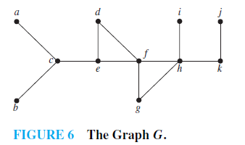
Depth-First search
Example 3
School of Computer Science, BUPT

Slide 28
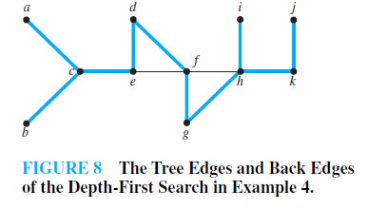
Example 4
The edges selected by depth-first search of a graph are called tree edges.
All other edges of the graph must connect a vertex to an ancestor or descendant of this vertex in the tree. These edges are called back edges.
School of Computer Science, BUPT

Slide 29
Algorithm 1 Depth-first search
procedure DFS(G: connected graph with vertices v₁,v₂,…v_{n})
T:=tree consisting only of the vertex v₁
visit(v₁)
procedure visit (v: vertex of G)
for each vertex w adjacent to v not yet in T
begin
  add vertex w and edge {v, w} to T
  visit (w)
end
School of Computer Science, BUPT

Slide 30
Breadth-First Search
procedure BFS(G: connected graph with vertices v₁,v₂,…v_{n})
T:=tree consisting only of the vertex v₁
L:=empty list
put v₁ in the list L of unprocessed vertices
while L is not empty
begin
remove the first vertex, v, from L
for each neighbor w of v
If w is not in L and not in T then
  begin
  add w to the end of the list L
  add w and edge {v, w} to T
  end
end
School of Computer Science, BUPT

Slide 31
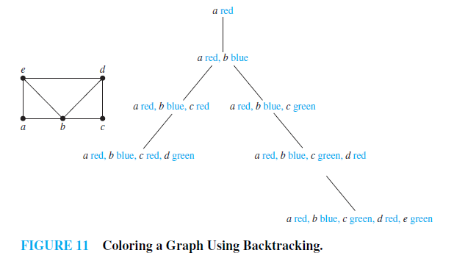
Backtracking applications
Graph colorings
School of Computer Science, BUPT

Slide 32
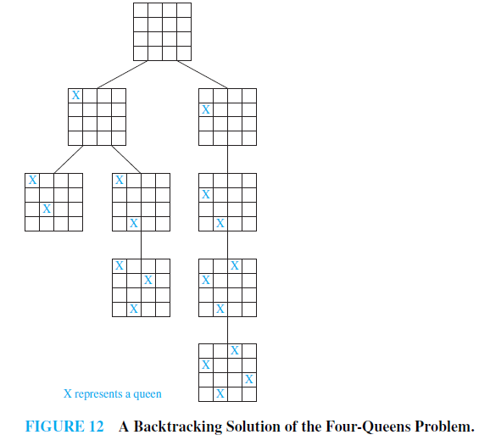
Backtracking applications
The n-Queens Problem
School of Computer Science, BUPT

Slide 33
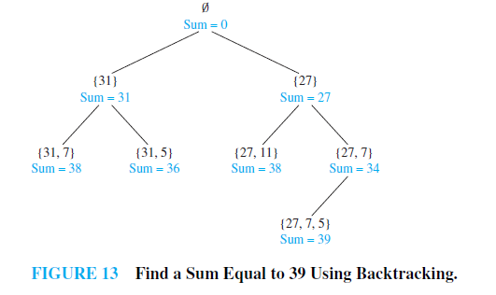
Backtracking applications
Sums of Subsets
School of Computer Science, BUPT

Slide 34
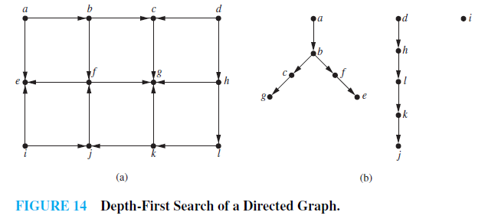
Depth-first search in directed graphs
Example 9
Web Spiders
School of Computer Science, BUPT

Slide 35
Homework
§11.4
  12, 14
School of Computer Science, BUPT

